Slide 1
Final Challenge
Autonomous exploration

Slide 2
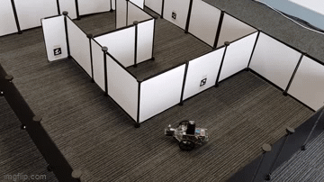
Final Challenge
Introduction
This challenge is intended for the student to review the concepts introduced in this course.
This challenge consists in autonomously exploring an unknown environment using the Puzzlebot.
The challenge must be implemented in Gazebo, and it is encouraged but not required to be implemented with the real robot.
This challenge is divided in two sections.

Slide 3
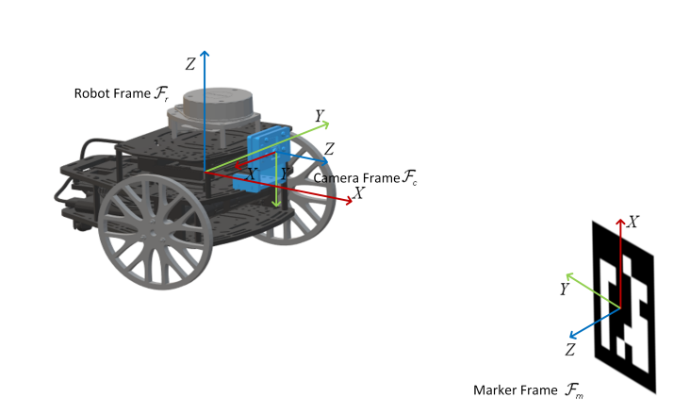
Final Challenge: Part 1
Localisation
The student must develop a camera-based EKF (Extended Kalman Filter) localisation algorithm based on artificial markers and odometry for the Puzzlebot.
The student must use ArUco Marker (fiducial) identification as the exteroceptive sensor measurement.
The algorithm must be implemented in ROS using vision algorithms for ArUco Marker pose detection.
The student must perform all the required coordinate transformations and camera parameter identification for a robust performance.

Slide 4
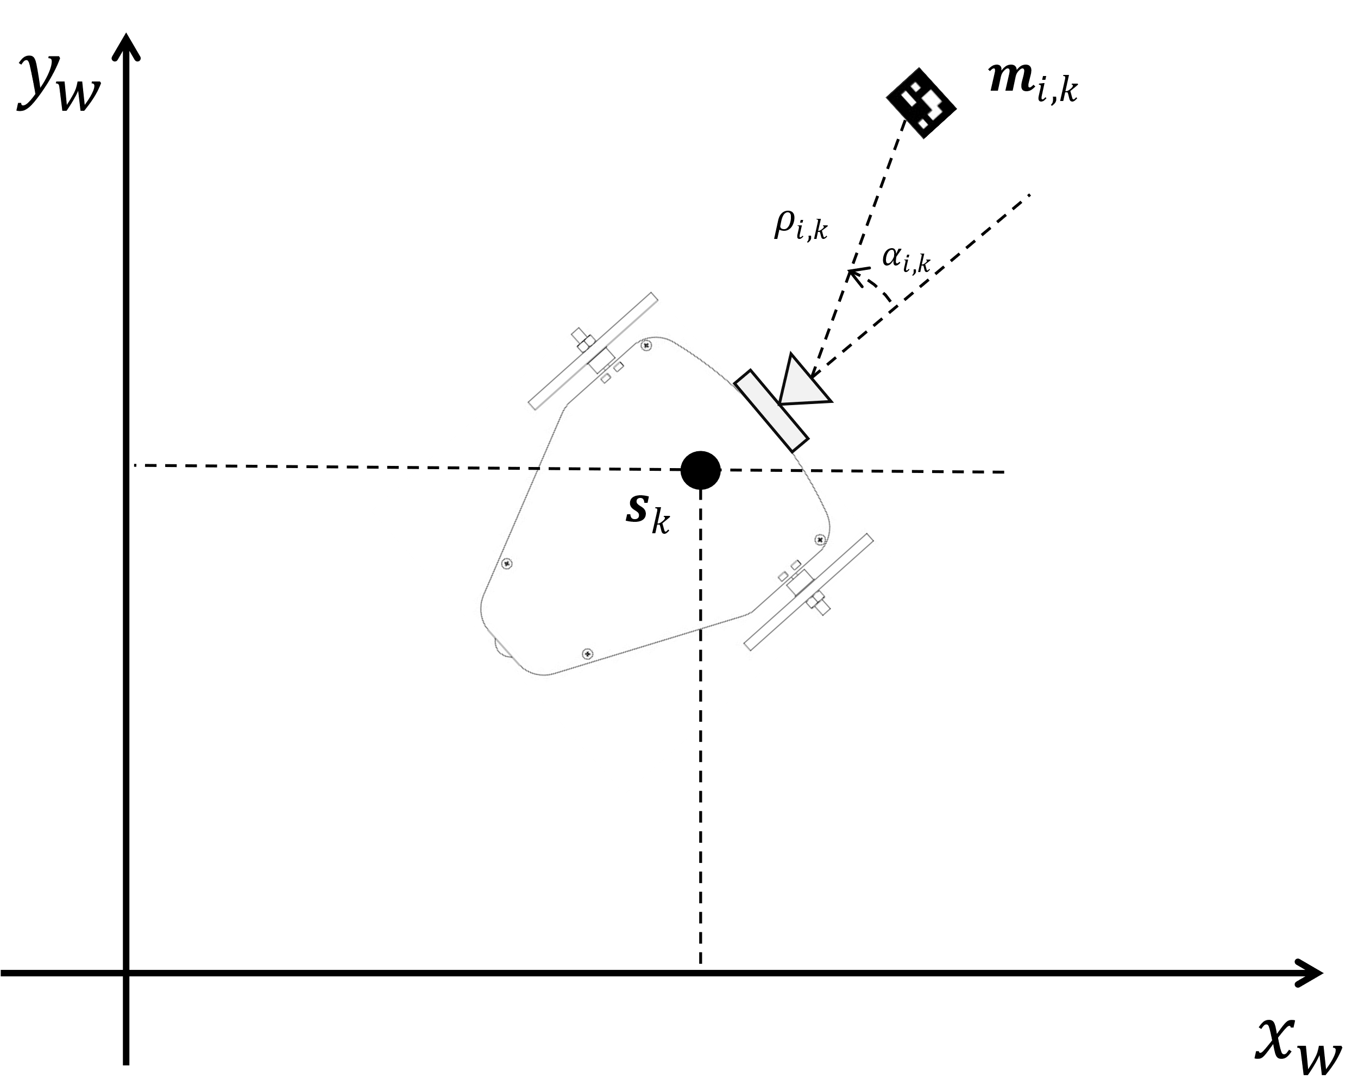
Final Challenge: Part 1
Localisation
The student must adequately identify or generate the observation model.
It is encouraged for the student to test different observation models for the correction step.
The student must test their localisation library in different scenarios, such as multiple marker observation, no marker observation, partial marker observation, etc. to prove its robustness.
The student can select any ArUco Marker dictionary.

Slide 5
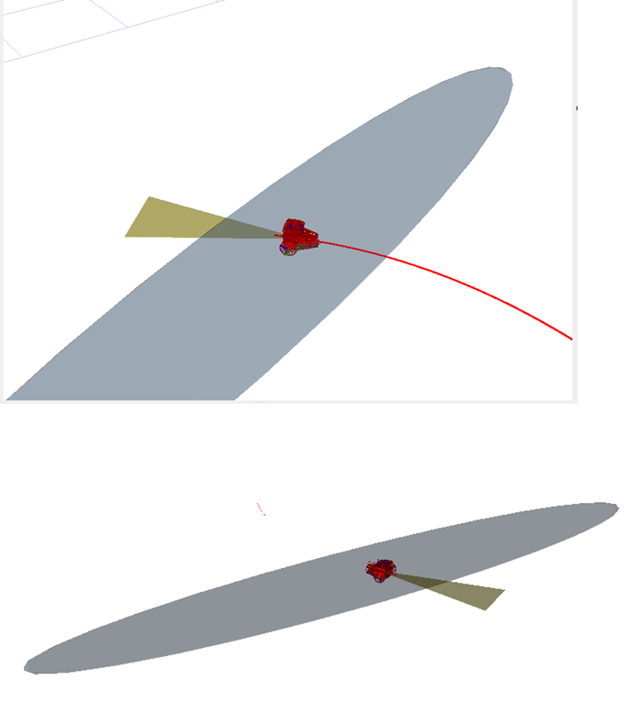
Final Challenge: Part 1
Localisation
The student must plot the confidence ellipsoids in RVIZ and their evolution over time. i.e., when the Puzzlebot cannot see the marker, when it sees it again, etc.
The student must define evaluation metrics of their algorithm to verify robustness.
The student can use any number of ArUco Markers for localisation, as long as it states the reason for choosing them.
The student must define robustness and implement strategies to achieve it.
The student must explain the reasoning behind every engineering decision made.
It is forbidden to use any other library apart from ArUco library, OpenCV and Matrix manipulation libraries such as eigen, lapack or numpy.

Slide 6
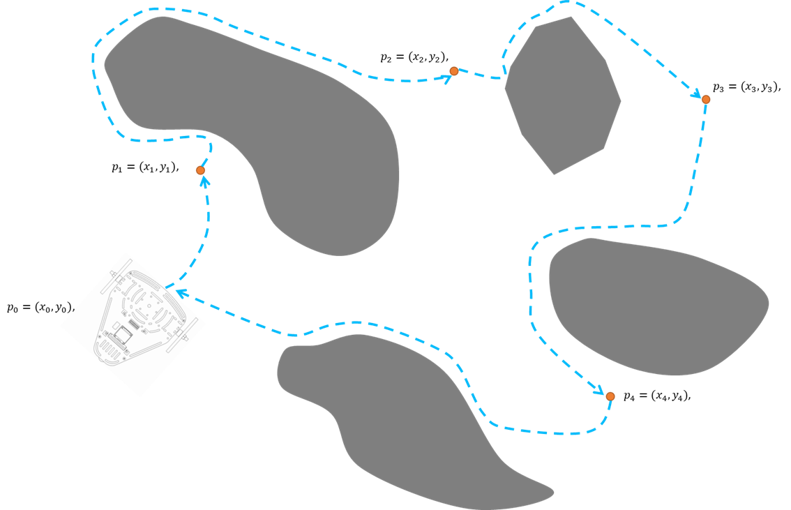
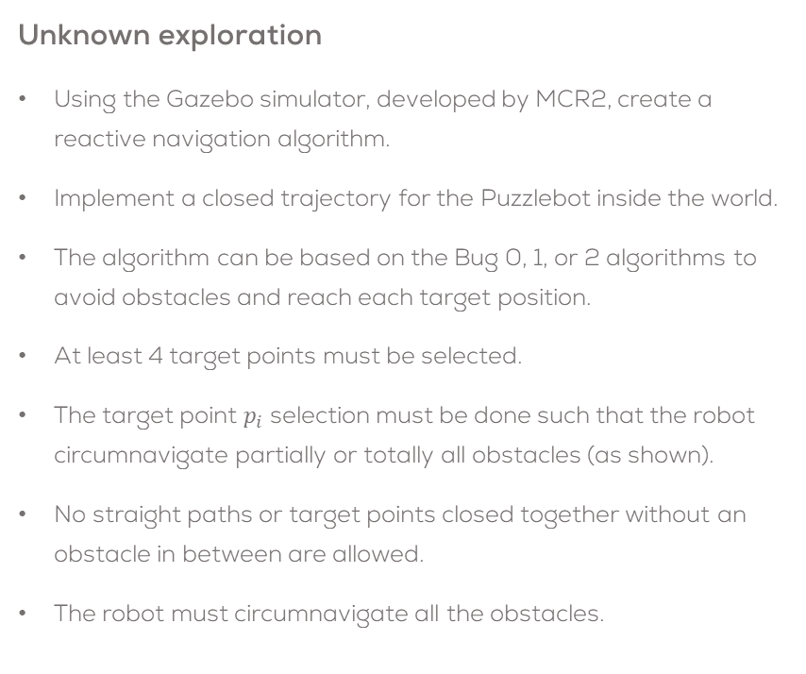
Final Challenge: Part 2
Unknown exploration
Using the Gazebo simulator, developed by MCR2, create a reactive navigation algorithm.
Implement a closed trajectory for the Puzzlebot inside the world.
The algorithm can be based on the Bug 0, 1, or 2 algorithms to avoid obstacles and reach each target position.
At least 4 target points must be selected.
The target point $p_{i}$ selection must be done such that the robot circumnavigate partially or totally all obstacles (as shown).
No straight paths or target points closed together without an obstacle in between are allowed.
The robot must circumnavigate all the obstacles.

Slide 7
Final Challenge: Part 2
Unknown exploration
The students are encouraged to create different scenarios, to test their algorithms.
To start, the student can test their own algorithm in the worlds defined by MCR2.
The student must analyse and take into consideration the growing covariance around the pose of the robot.
The students must define the required launch files for this activity.
The students must define a correct sampling time for the simulation.
The usage of any library is strictly forbidden.

Slide 8
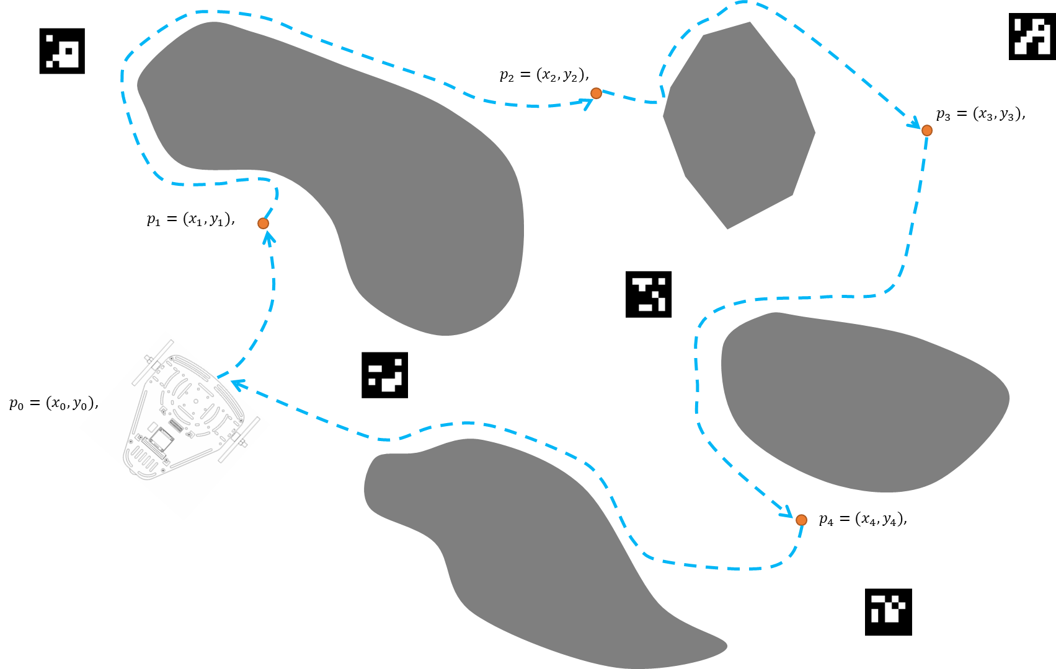
Final Challenge: Part 2
Unknown exploration
Combine the visual EKF localisation algorithm developed in part 1 with the autonomous exploration and obstacle avoidance algorithm developed in this section of the challenge.
The student must place the markers in key places to perform a good localisation.
The student must use at least 4 ArUco Markers.
The student can use as many markers as required.

Slide 9
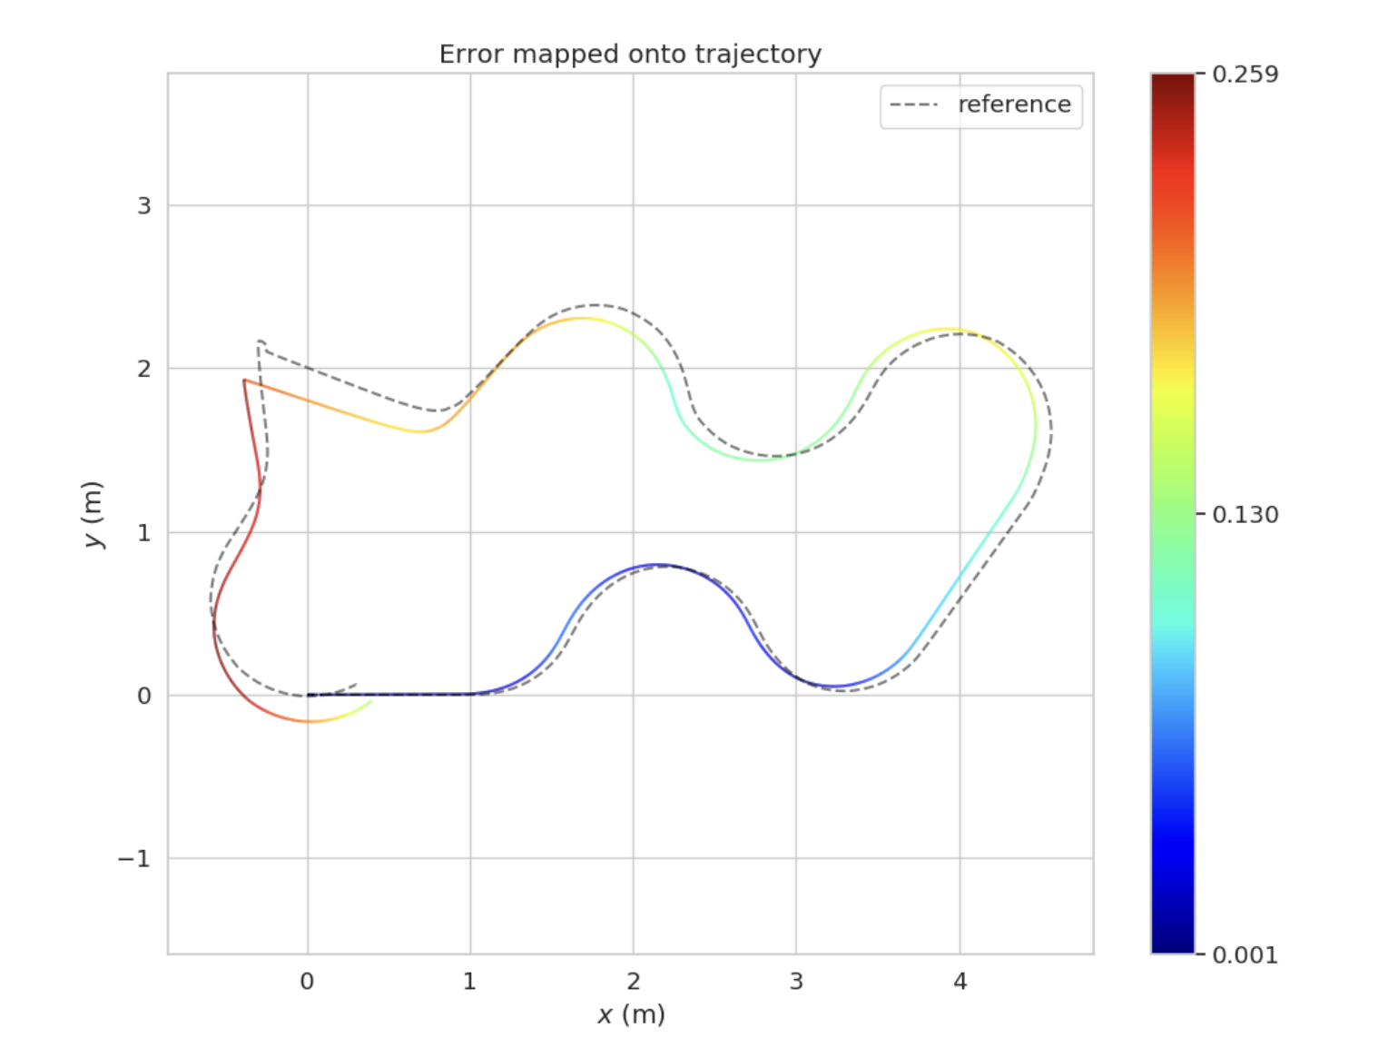
Final Challenge: Part 2
Unknown exploration
The student is encouraged to test their algorithms in different scenarios.
To start, the student can test their own algorithm in the worlds defined by MCR2.
The student must plot and analyse the covariance ellipsoids around the pose of the robot in RVIZ.
The student must define evaluation metrics of their algorithm to verify robustness.
The student must test their scenarios by removing several ArUco Markers, partially obstructing them or having multiple markers at once.

Slide 10
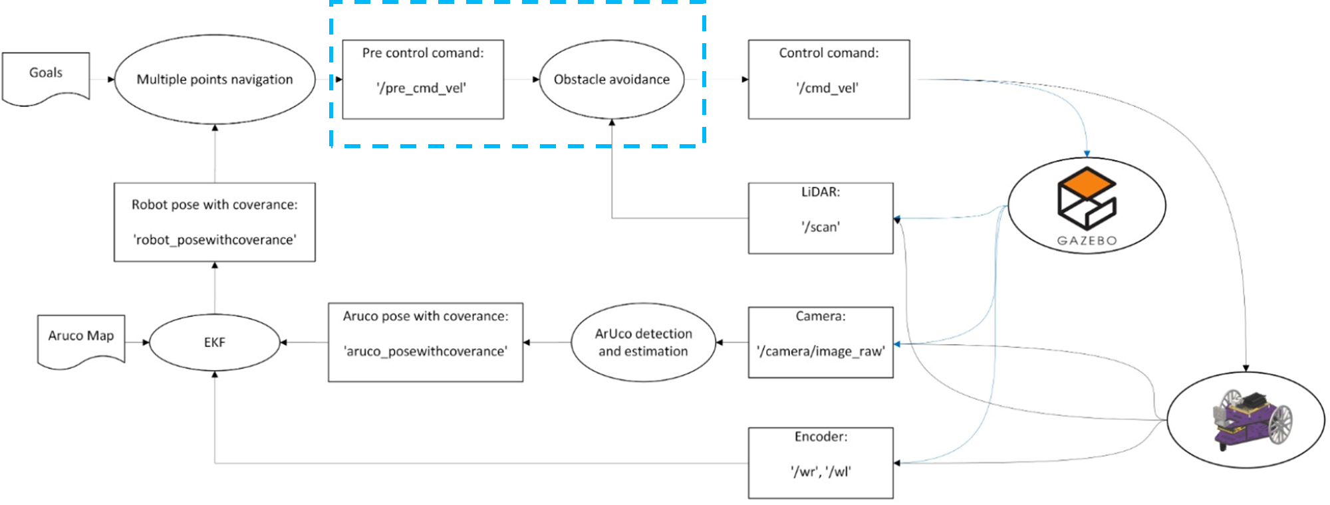
Final Challenge: Part 2
Unknown exploration
The students must define the required launch files for this activity.
The students must define a correct sampling time for the simulation.
The student must explain the reasoning behind every engineering decision made.
It is forbidden to use any other library apart from ArUco library, OpenCV and Matrix manipulation libraries such as eigen, lapack or numpy.

Slide 11
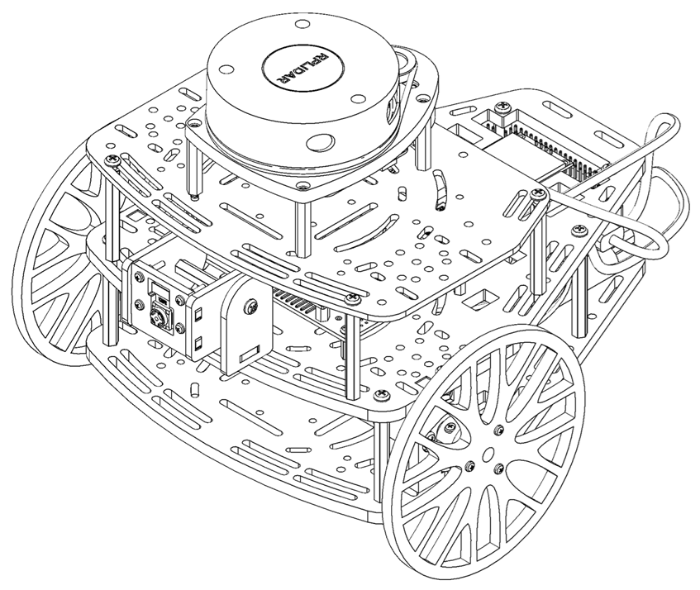
Literature
ArUco Marker Detection
ArUco Marker Module
Camera Calibration
Camera Calibration example
Camera Models
Visual localisation of mobile robots
EKF Localisation
EKF Localisation WSN
Guaranteed Slam An Interval Approach. [PhD thesis]
Guaranteed SLAM an Interval Approach
Automatic generation and detection of highly reliable ﬁducial markers under occlusion
Interval Extended Kalman Filter—Application to Underwater Localization and Control

Slide 12
Rules
This is challenge not a class. The students are encouraged to research, improve tune explain their algorithms by themselves.
MCR2(Manchester Robotics) Reserves the right to answer a question if it is determined that the questions contains partially or totally an answer.
The students are welcomed to ask only about the theoretical aspect of the classed.
No remote control or any other form of human interaction with the simulator or ROS is allowed (except at the start when launching the files).
It is forbidden to use any other internet libraires with the exception of standard libraires or NumPy.
If in doubt about libraires please ask any teaching assistant.
Improvements to the algorithms are encouraged and may be used as long as the students provide the reasons and a detailed explanation on the improvements.
All the students must be respectful towards each other and abide by the previously defined rules.
Manchester robotics reserves the right to provide any form of grading. Grading and grading methodology are done by the professor in charge of the unit.

